Slide 1
Overview and Background of the Multi-scale Integrated Model of Ecosystem Services ( MIMES) Roelof Boumans February 2016
Notes:
LABELS ON THE SLIDE?

Slide 3
The Goal of MIMES:
Create a modeling tool which can incorporate stakeholder input and biophysical data sets for valuation of ecosystem services and decision-making:
Simulate ecosystems and Socio-Economic systems in space
Simulate these systems over time
Simulate the interactions between these systems through coupling

Slide 4
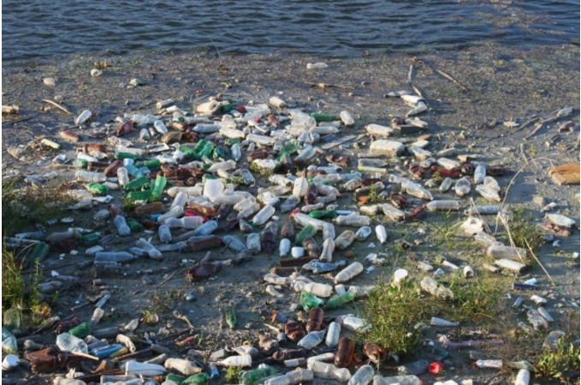
Accounting Framework For Modeling Ecosystem Services
 | Economic sector “Use” | Ecosystem “Use”
Economic Sector “Make” | Human Interactions | Ecosystem Impacts
Ecosystem “Make” | Ecosystem Services | Ecosystem Processes

Slide 5
MIMES The Multi-Scale Integrated Model of Ecosystem Services
Notes:
Can we rework this a bit? Give an example from later slides?

Slide 6
Simile

Slide 7
Tonlesap Model Diagram
Time series inputs
Fish attributes and outside dynamics
Hydrology
27 Fish species
User group attributes
30 Locations
4 user groups
12 land covers
4 Land
Uses
Land Cover Attributes
Polygon
outputs
4 p. producers
Land Use Attributes
Time series outputs

Slide 8
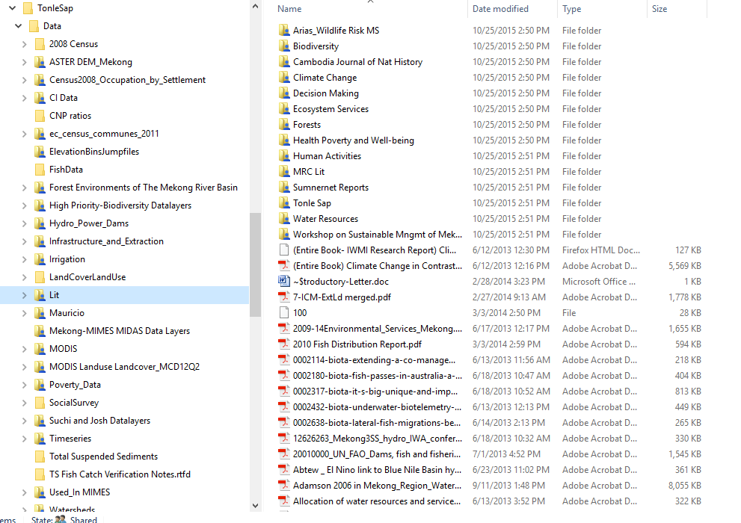
MIMES Data bases

Slide 9
Scenario Modeling
Characteristics:
Aim is not to predict one exact picture of the future, but to present several alternative future developments.
Possible future outcomes are observable. Observations can be used to validate scenario trajectories
Scenario models are connected to the past, but are not extrapolations
Scenarios do not rely on historical data and do not expect past observations to be still valid in the future.
Scenarios consider potential developments and turning points.
Notes:
CONTRADICTIONS??????

Slide 10
The “Decision” Table for Scenario Development Investment decisions towards capital in economic sectors
 | Agriculture | Fisheries | Mining | Manufacturing | Households
Households | Localized Consumption |  |  |  | Life style changes
Industry |  | Change in fishing gear |  | The development of energy efficient production methods
Government | Farm bill to favor environmental friendly production methods | Ecosystem based management
Climate Change Adaption Scenarios

Slide 12
Examples of MIMES models

Slide 13
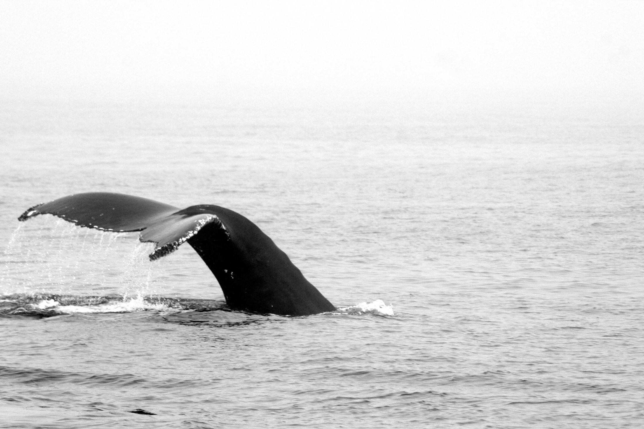
Decision support for ecosystem-based management of the Massachusetts coast: Evaluating ecosystem service tradeoffs in a spatially explicit, dynamic context
Author: Roelof Boumans, AFORDablefutures, USA Coauthors: Les Kaufman, Boston University Irit Altman, Boston University Joe Roman, University of Vermont

Slide 15
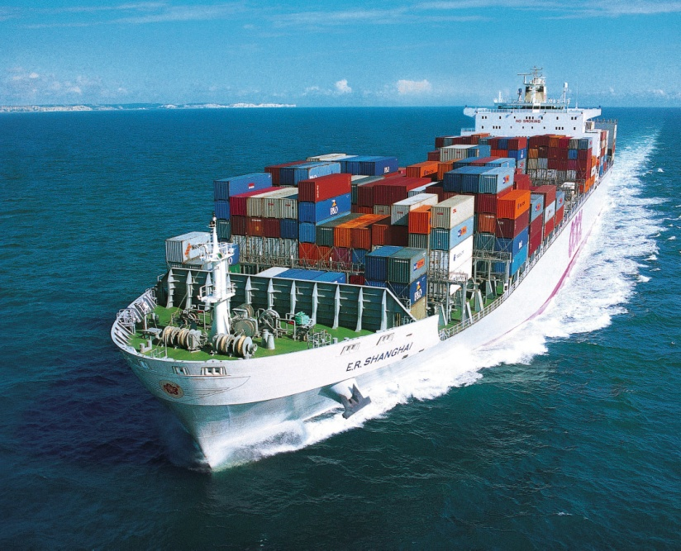
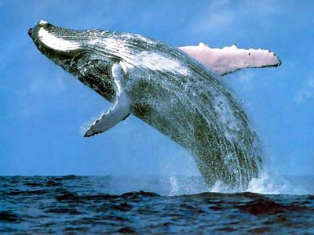
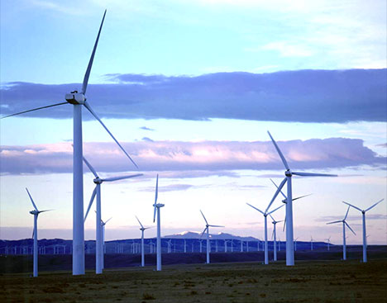
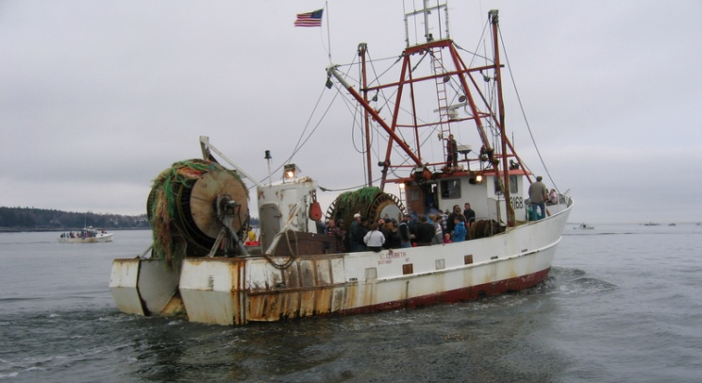
Calculating MIMES Trade-offs among users of Marine resources

Slide 16
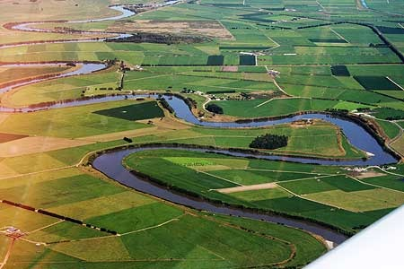
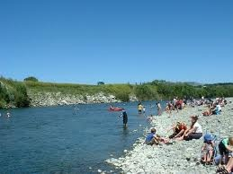
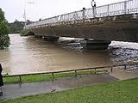
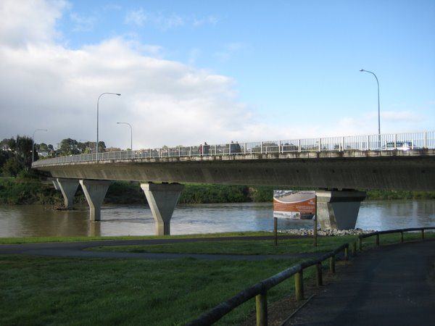
The Manawatū River Catchment
Highly modified catchment
133,000 people
320,000 cows
Protecting assets, livelihoods

Slide 17
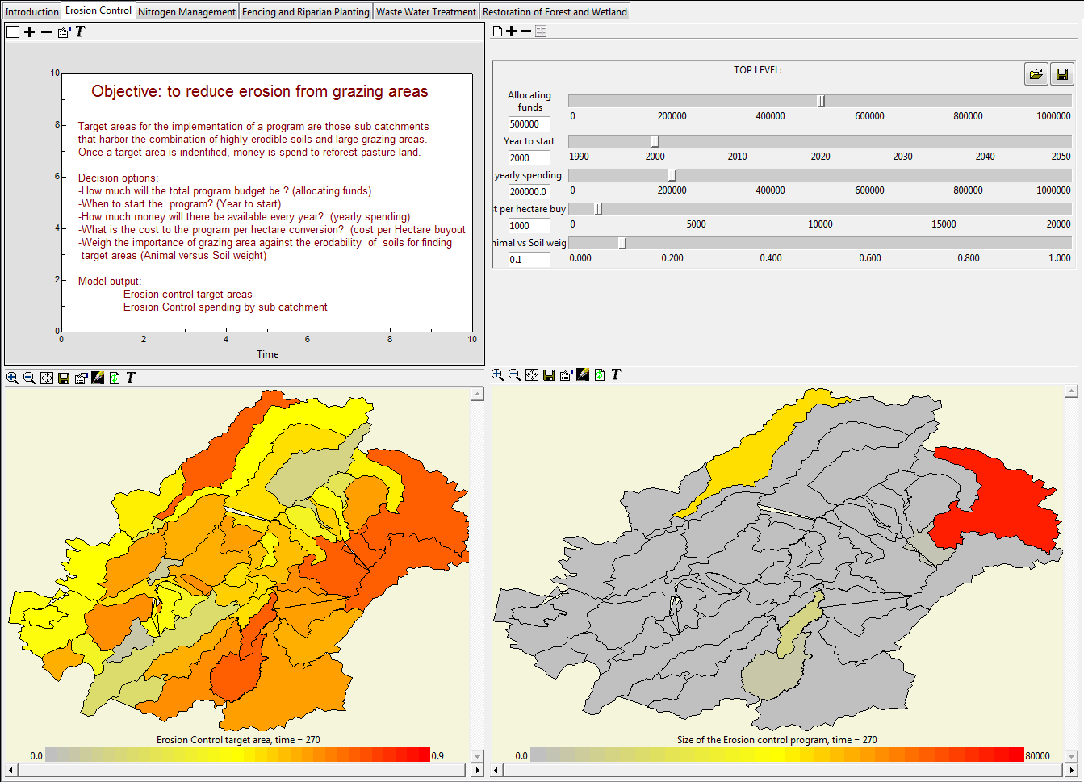
Interface for the design of Erosion Control scenarios

Slide 19
Melting of the Glacier

Slide 20
HYGEIA Model

Slide 22
HYGEIA Scenarios

Slide 23
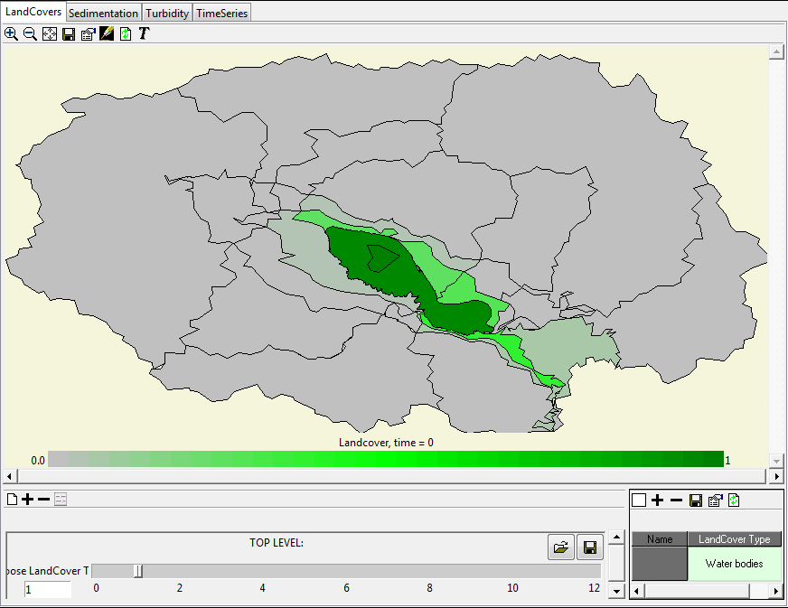
Tonlesap Cambodia

Slide 24
Tonlesap Cambodia

