Slide 1


MARCH 15, 2018

Slide 2
Agenda
Presenter & Participant Introductions
Workshop Framework
MIDAS Tool
Demonstration of MIDAS
Interactive Exercises
Feedback & Questions
Speakers:
Suchi Gopal
Joshua Pitts
Find Out More:
http://www.chansmodels.org

Slide 3



Introduction
Speakers:
Suchi Gopal
Joshua Pitts
Dr. Suchi Gopal
Joshua Pitts
Professor, Decision Support
Software Design & Engineering

Slide 4
Workshop Framework
Speakers:
Suchi Gopal
Joshua Pitts

Slide 5
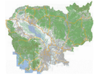
Decision Support Tools
Context
Stakeholder Engagement
Data & Model Building
MODELS
& Data
Analysis & Results
Proprietary and Confidential
Notes:
ECONOMIC ANALYSIS OF ECOSYSTEM
SERVICES IN THE MEKONG BASIN
Lucy Emerton
Report prepared for WWF Greater Mekong Programme
20 February 2011

Slide 6
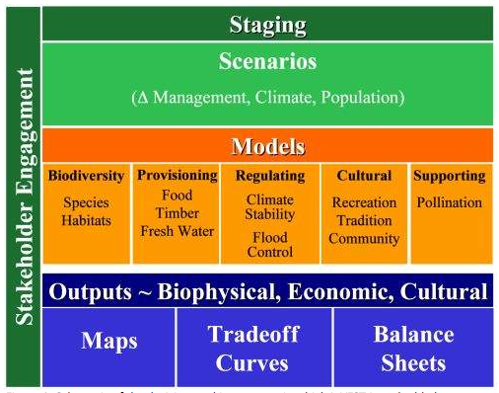
Framework : Environmental Valuation & Tradeoffs
Proprietary and Confidential

Slide 7
MIMES & MIDAS
Notes:
ECONOMIC ANALYSIS OF ECOSYSTEM
SERVICES IN THE MEKONG BASIN
Lucy Emerton
Report prepared for WWF Greater Mekong Programme
20 February 2011

Slide 8
MIDAS Tool: Assisted Decision-Making
Speakers:
Suchi Gopal
Joshua Pitts
Food, Water & Energy Analysis in MIDAS

Slide 9
MIDAS Goals
Overview
1.MIDAS has kept pace with technology - Web enabled
2.Multi-source data from NASA, Cambodian Govt, Crowd sourcing (volunteered information - ratings just as in Amazon)
3.Multi-stakeholder collaboration – each wants a different output and can share/collaborate
4.Many tools being added to enhance your needs – Siem Reap Urbanization
5.Education & Outreach– Curriculum developed, Webinars, Undergrad and graduate students
6.MIDAS used now in Belize, Brazil, Key Biscayne (USA), Cambodia etc.
Notes:
ECONOMIC ANALYSIS OF ECOSYSTEM
SERVICES IN THE MEKONG BASIN
Lucy Emerton
Report prepared for WWF Greater Mekong Programme
20 February 2011

Slide 10
MIDAS Sources
Source of Data
MIDAS is based on the primary and secondary data gathered by our team, Professors Les Kaufman, Suchi Gopal, Irit Altman, Roel Boumans, and Josh Pitts, as well as many graduate students at Boston University. A number workshop delegates from Cambodia at the Ministry of Fisheries, NGOs, and other stakeholders helped to develop, improve and enhance MIDAS.
Notes:
ECONOMIC ANALYSIS OF ECOSYSTEM
SERVICES IN THE MEKONG BASIN
Lucy Emerton
Report prepared for WWF Greater Mekong Programme
20 February 2011

Slide 11
MIDAS
MIDAS is web browser based – i.e. it can be run through no more software than an up-to- date internet browser, such as Mozilla Firefox.
Access at
Chansmodels.org or
http://45.55.215.153/midas/#
Notes:
ECONOMIC ANALYSIS OF ECOSYSTEM
SERVICES IN THE MEKONG BASIN
Lucy Emerton
Report prepared for WWF Greater Mekong Programme
20 February 2011

Slide 12
History of MIDAS
Speakers:
Suchi Gopal
Joshua Pitts
Food, Water & Energy Analysis in MIDAS

Slide 13
MIDAS In Belize
Notes:
ECONOMIC ANALYSIS OF ECOSYSTEM
SERVICES IN THE MEKONG BASIN
Lucy Emerton
Report prepared for WWF Greater Mekong Programme
20 February 2011

Slide 14
MIDAS In Belize: (1) Identify Motivations
Notes:
ECONOMIC ANALYSIS OF ECOSYSTEM
SERVICES IN THE MEKONG BASIN
Lucy Emerton
Report prepared for WWF Greater Mekong Programme
20 February 2011

Slide 15
Tradeoff Analysis in Massachusetts, United States
Notes:
ECONOMIC ANALYSIS OF ECOSYSTEM
SERVICES IN THE MEKONG BASIN
Lucy Emerton
Report prepared for WWF Greater Mekong Programme
20 February 2011

Slide 16
Data Explorer in Florida, United States
Notes:
ECONOMIC ANALYSIS OF ECOSYSTEM
SERVICES IN THE MEKONG BASIN
Lucy Emerton
Report prepared for WWF Greater Mekong Programme
20 February 2011

Slide 17
MIDAS in Cambodia
Notes:
ECONOMIC ANALYSIS OF ECOSYSTEM
SERVICES IN THE MEKONG BASIN
Lucy Emerton
Report prepared for WWF Greater Mekong Programme
20 February 2011

Slide 18
MIDAS in Cambodia: Many Activities Help Decision Making
Notes:
ECONOMIC ANALYSIS OF ECOSYSTEM
SERVICES IN THE MEKONG BASIN
Lucy Emerton
Report prepared for WWF Greater Mekong Programme
20 February 2011

Slide 19
MIDAS Demonstration
Speakers:
Suchi Gopal
Joshua Pitts

Slide 20
MIDAS: Walkthrough
Zoom to Area
CDF Explorer
FEWS Explorer
MIMES Explorer
Explore Cambodia Data
Siem Reap Urbanization
Freshwater Health Index
Proprietary and Confidential
Notes:
ECONOMIC ANALYSIS OF ECOSYSTEM
SERVICES IN THE MEKONG BASIN
Lucy Emerton
Report prepared for WWF Greater Mekong Programme
20 February 2011

Slide 21
MIDAS: Walkthrough
Siem Reap Urbanization: Rapid urbanization in Siem Reap near Angkor Wat is causing rapid depletion of water as population growth has accelerated in the last two decades. We show the deforestation and urbanization trends in this region using Landsat image analysis.
Freshwater Health Index: CI's Freshwater Health Index is a tool that measures ecosystem system health by making clear connections between freshwater ecosystems and the benefits they provide to people. The user can access the information through links.
Proprietary and Confidential
Notes:
ECONOMIC ANALYSIS OF ECOSYSTEM
SERVICES IN THE MEKONG BASIN
Lucy Emerton
Report prepared for WWF Greater Mekong Programme
20 February 2011

Slide 22
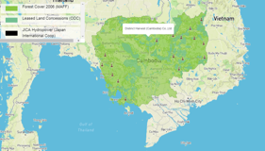
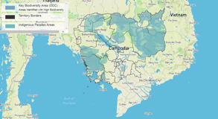
1. Map Exploration
The map exploration tool enables the user to display a series of data layers including administrative units, forests, population, watersheds and rivers. MIDAS shows map layers based on identification of user types. Users for Cambodia are classified into the following groups based on our interactions with user groups in stakeholder workshops from 2014-2017. We will survey if more user groups are needed. Our goal is to create a multi-stakeholder platform that can provide specific layering of our models to the user groups. For example a commercial fisher may need details of fish catch, fish biomass and no-take zones while an environmental group may want detailed information of areas at risk.
Proprietary and Confidential
Notes:
ECONOMIC ANALYSIS OF ECOSYSTEM
SERVICES IN THE MEKONG BASIN
Lucy Emerton
Report prepared for WWF Greater Mekong Programme
20 February 2011

Slide 23
1. Map Exploration
Frame a problem.
Select relevant data
Gather insights from your visual map overlay – quick and easy way of gathering insights
For example, ADD forest concessions, forest in 2006 and key biodiversity areas.
Zoom into Mondulkiri – What is the spatial pattern here? Locate all leased concessions here.
Locate Phnum Prech Wildlife Sanctuary? What are the threats here?
Proprietary and Confidential
Notes:
Northeastern Cambodia’s Mondulkiri Province, at the core of the EPL, is recognized as one of the 200 most important areas for global biodiversity by WWF.Mondulkiri's two protected areas, Srepok Wildlife Sanctuary (SWS: 363,177ha) and Phnom Prich Wildlife Sanctuary (PPWS: 222,500ha) contain a large diversity of habitats ranging from hill evergreen to open dry forest, and supports resident populations of many endangered species including Asian elephant, tiger, leopard, banteng, Siamese crocodile, and Eld’s deer as well as several endangered large waterbirds and vultures.

Slide 24
1. Map Exploration
Examine forest and threats in Ratanakiri, Mondulkiri, Kratie and Stung Treng that are the richest and largest intact block of forest in southeast Asia. What data layers would you use?
What are the threats here – how would you assess ecotourism potential here?
What are alternate livelihoods here?
Proprietary and Confidential
Notes:
ECONOMIC ANALYSIS OF ECOSYSTEM
SERVICES IN THE MEKONG BASIN
Lucy Emerton
Report prepared for WWF Greater Mekong Programme
20 February 2011

Slide 25
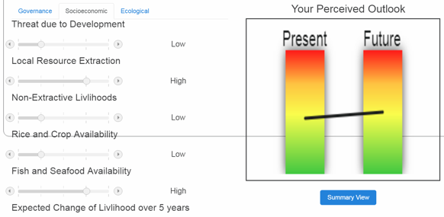
2. Collaboration Via CDFs
Users have their intuitive and experiential understanding of the political, social, and environmental dimensions of the state of the system. MIDAS enables users to rate or review the system on critical determining factors, gathered from our prior research in other regions and revised to fit the Cambodian context:
Proprietary and Confidential
Notes:
ECONOMIC ANALYSIS OF ECOSYSTEM
SERVICES IN THE MEKONG BASIN
Lucy Emerton
Report prepared for WWF Greater Mekong Programme
20 February 2011

Slide 26
CDF Example
1. Stakeholder involvement: This variable defines the level of stakeholder involvement that results in an overall positive impact on the region. Level of stakeholder involvement in surveillance, monitoring and enforcement is a useful measure of how successful a region would be in the present as well as in the future. (Cho, 2005; Pomeroy et al., 2000). Stakeholder involvement can be effective in controlling non-compliance behavior through social and peer pressure. Increased participation of stakeholders provides them with more ownership over the resources (such as fishing and forestry) which should result in overall improvement. Active involvement in stakeholder activities is highly beneficial to any governance. This measures how active people are in resource management. This user group ranking gives us an overall view of the significance of resources to the public. The more people value the resources, the more likely they are to participate in management (Bunce et al, 2000). An increase in participation would be a positive impact of any development or conservation effort (Pomeroy et al, 1997).
Very low: The level of participation is almost non-existent and hence resources are not well managed.
Low: Low level of participation may lead to negative impacts.
Moderate: Moderate stakeholder participation levels resulting in a slightly higher positive impact for the region.
High: Involves high level of involvement from a relatively large proportion of stakeholders
Very High: Surveillance, monitoring and enforcement leads to improvement in overall community compliance and enforcement.
V. Low | Low | Moderate | High | V. High
Proprietary and Confidential
Notes:
ECONOMIC ANALYSIS OF ECOSYSTEM
SERVICES IN THE MEKONG BASIN
Lucy Emerton
Report prepared for WWF Greater Mekong Programme
20 February 2011

Slide 27
2. Collaboration Via CDFs
Users have their intuitive and experiential understanding of the political, social, and environmental dimensions of the state of the system. MIDAS enables users to rate or review the system on critical determining factors, gathered from our prior research in other regions and revised to fit the Cambodian context:
How would you manage sensitive areas in Ratanakiri? How would you support human livelihoods here? Use CDFs to assess the situation as a group?
Which CDF was considered most important? Why?
Which CDF produced largest variation in your group? Why?
Proprietary and Confidential
Notes:
ECONOMIC ANALYSIS OF ECOSYSTEM
SERVICES IN THE MEKONG BASIN
Lucy Emerton
Report prepared for WWF Greater Mekong Programme
20 February 2011

Slide 28
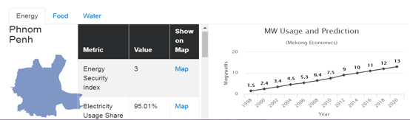
3. Food, Energy and Water Securities Assessment
The food-energy-water nexus (FEWS) is among the highest priorities of the Rio + 20 Declaration and is very relevant in the context of Cambodia, where food, energy and water systems are inextricably linked throughout Cambodia. Rapid changes from hydro-power development, over-fishing, forest clearing, and urbanization threaten the future of the Cambodia’s tightly linked natural and human systems. These pressures are aggravated by rapid human population growth, migration (increasing urbanization), and the impacts of global climate change. Specific development strategies around FEWS must be critically evaluated in order to consider their system-wide effects and understand the net gain and loss to the suite of ecosystem services that Cambodians depend upon.
Proprietary and Confidential
Notes:
ECONOMIC ANALYSIS OF ECOSYSTEM
SERVICES IN THE MEKONG BASIN
Lucy Emerton
Report prepared for WWF Greater Mekong Programme
20 February 2011

Slide 29
3. FEWS modeling
Engie, a French multinational electric utility company, and Devenco, a local enterprise, have entered a partnership that could lead to the construction of a solar power plant in Kampong Chhnang province,
Describe geography of this province? What is its population?
What is the solar power potential here?
What is the electricity usage here?
Proprietary and Confidential
Notes:
n August, a $12.5-million, 10-megawatt solar farm in Svey Rieng province’s Bavet city – the country’s first solar power plant – came into service, selling energy to the national grid under a 20-year power purchase agreement.
In September, Global Purify Power started groundbreaking work for a $400-million solar power project in Kampong Speu province that will be capable of producing 225 megawatts.
Energy production increased from 3.64Mtoe in 2008 to 5.35 Mtoe in 2011 to 5.5Mtoe in 2012.
(MTOE is an acronym that may refer to: Million Tons of Oil Equivalent) Graphs to show Cambodia’s energy mix or supply, energy demand by sector and electricity supplies in 2011 (Source: International Energy Agency).
2011
2012
Biomass
71%
71%
Petroleum
26%
25.10%
Imported Electricity
3%
3%
Hydro power
0.80%
Coal
0.20%
Total Consumption
5351 KTOE
5500KTOE
Electricity Supplies 2011 (International Energy Agency IEA)

Slide 30
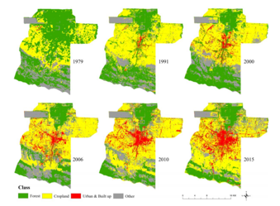
4. Assessment - Siem Reap Urbanization
Our stakeholder workshop in 2016 in Siem Reap kindled an interest in evaluating change in urbanization around the tourist destination of Angkor Wat, formally recognized as a World Heritage site by UNESCO in the 1990’s. The temple is located to the north of the city.
In this study, we used several Landsat images during the period of 1979 to 2015, including satellite images from Landsat MSS, Landsat TM and Landsat OLI. We derived the land use and land cover maps based on a random forest classifier using 1979, 1991, 2000, 2006, 2010, and in 2015 images. We classified the landcover into forest, crop, urban and others, seen left, to investigate the urbanization and deforestation.
Proprietary and Confidential
Notes:
ECONOMIC ANALYSIS OF ECOSYSTEM
SERVICES IN THE MEKONG BASIN
Lucy Emerton
Report prepared for WWF Greater Mekong Programme
20 February 2011

Slide 31
4. Siem Reap
Frame an urbanization problem for Siem Reap,
What is the pattern of urbanization in Siem Reap?
What is the role of the road network in this region?
Describe the relationship between urban landuse with forest and cropland?
Proprietary and Confidential
Notes:
n August, a $12.5-million, 10-megawatt solar farm in Svey Rieng province’s Bavet city – the country’s first solar power plant – came into service, selling energy to the national grid under a 20-year power purchase agreement.
In September, Global Purify Power started groundbreaking work for a $400-million solar power project in Kampong Speu province that will be capable of producing 225 megawatts.
Energy production increased from 3.64Mtoe in 2008 to 5.35 Mtoe in 2011 to 5.5Mtoe in 2012.
(MTOE is an acronym that may refer to: Million Tons of Oil Equivalent) Graphs to show Cambodia’s energy mix or supply, energy demand by sector and electricity supplies in 2011 (Source: International Energy Agency).
2011
2012
Biomass
71%
71%
Petroleum
26%
25.10%
Imported Electricity
3%
3%
Hydro power
0.80%
Coal
0.20%
Total Consumption
5351 KTOE
5500KTOE
Electricity Supplies 2011 (International Energy Agency IEA)

Slide 32
5. MIMES Tradeoff Modeling
Tonle Sap MIMES is a dynamic ecosystem model that connects knowledge about hydrological flows, landcovers, primary production, and fish. The goals of the model are multi-pronged including 1) to provide a framework for current and future knowledge integration and synthesis, 2) to provide a learning and educational resource to users in the system, and 3) to support the exploration of ‘what if scenarios’ to understand the system-wide effects of threats. The model was developed using many scientific insights about the system and its overall accuracy has been verified using available sources of observed data.
Proprietary and Confidential
Notes:
ECONOMIC ANALYSIS OF ECOSYSTEM
SERVICES IN THE MEKONG BASIN
Lucy Emerton
Report prepared for WWF Greater Mekong Programme
20 February 2011

Slide 33
MIMES Tonle Sap Background
Tonle Sap MIMES is a dynamic ecosystem model that connects knowledge about hydrological flows, landcovers, primary production, and fish.
The goals of the model are multi-pronged including 1) to provide a framework for current and future knowledge integration and synthesis, 2) to provide a learning and educational resource to users in the system, and 3) to support the exploration of ‘what if scenarios’ to understand the system-wide effects of threats.
The model was developed using many scientific insights about the system and its overall accuracy has been verified using available sources of observed data. However, there are also areas of the model that can be strengthened in order to increase the precision of outputs and expand upon the knowledge included.
Notes:
Description of modeling approach and goals

Slide 34
MIMES Tonle Sap Background cont.
An essential input that drives the model is a time series of water levels which sets the conditions for the annual flood pulse that drives many production processes across the system. In developing and verifying the model, a time series based on observed levels was used, thus allowing for outputs associated with production flows to be compared to available observations of this system.
In contrast, when developing ‘what if’ scenarios to explore potential future impacts on hydrology and other factors, a time series of simulated water levels is used. This approach allows us to isolate hydrological factors of critical interest and also to remove sources of unexplained variability in the hydrological cycle. Furthermore, we have developed a supporting model tool that allows for easy construction and modification of simulated water levels, such that additional ‘what if’ scenarios can easily be run through Tonle Sap MIMES.
All ‘what if’ scenarios are compared to baseline model run which relies on a time series of simulated water levels that isolate two critical hydrological signals identified from observed data. First is the signal associated with annual flood cycle which is the result of highly predictable seasonal monsoons that occur in the region. Second is a signal that occurs at an interannual scale (~every 5 years) and corresponds roughly to the pattern of greater than average flooding followed by drought events that together are often referred to as an El Nino Southern Oscillation (ENSO) cycle.
Notes:
Approach to developing scenarios – focus on simulated water levels to understand ‘what if’ conditions

Slide 35
Scenario Design - Overview
‘What if’ scenarios in Tonle Sap MIMES are designed to explore the impacts of dams and climate change in this system.
Dam impacts include two factors associated with the construction and operation of dams – a reduction in annual flood pulse and the presence of migration barriers . These are considered as independent factors within the scenario design.
  First, dams are expected to reduce the annual flood cycle in this system. For Tonle Sap Lake, this will result in an increase in water levels and the area of permanent flood zone during the dry season and a decrease in the water levels and permanent flood zone during the wet season (on average). To explore this factor, ‘what if’ scenarios that include dam impacts rely on a simulated time series of water levels that reduce the amplitude of the annual flood cycle by 25% (a percentage which is in the range of the Definite Future dam scenario characterized by the Mekong River Commission).
  Second, dams are expected to have major impacts on the ability of migratory fish species to move freely between spawning and growing areas. To model this factor, mortality of migratory fish species was reduced relative to baseline conditions.
Climate change impacts are also considered within the scenario design via the general expectation that global warming will increase the intensity of the ENSO cycle. The climatological cycle associated with these events is known as the ENSO and occurs at an interdecadal scale. In ‘what if’ scenarios, the potential changes in ENSO are explored by increasing the amplitude of the ENSO-like cycle associated with the simulated water level input time series.
Notes:
Description of ‘what if’ scenario factors. There are two factors related to dams – reduced annual flooding and migration barriers. There is one factor related to climate change, which a change in intensity of ENSO-like wave function.

Slide 36
Scenario Factors
  Annual flood cycle (2 levels)
    Baseline level (AO): Simulated water levels produced using wave that match the annual hydrological cycle in this system*
    Definite Future Dams (A1): Simulated water levels which reduce the amplitude of annual flood cycle by 25% relative to the baseline
  ENSO-like cycle (2 levels)
    Baseline level (EO): Simulated water levels produced using wave that match an interdecadal hydrological cycle observed in this system. The cycle is associated with higher than normal flooding and drought events and is consistent with El Nino Southern Oscillation (ENSO) patterns*
    Increased ENSO intensity (EO): Simluated water levels which increase the amplitude of interdecadal, ENSO-like hydrological signal by 10% Fish migration
  Migration barriers (2 levels)
    No migration barriers (MO): Low juvenile mortality rates set for all fish groups inlcluding migrators (the rate for for short and long-distance migrators = 0.01)
    Migration barriers present (M1): juvenile mortality parameters for migrating fish groups is increased (long distance migrators = 0.1, short distance migrators=0.07)
*Wave metrics (i.e. sin, cosine, period) were identified through a Fournier analysis of observed water levels over 30 years
Notes:
More notes on scenario factors including identifiers that specify factor/level combination. These identifiers are used to specify parameter upload files (.spf files) in Simile language.

Slide 37
Notes:
One more way of communicating the factors/levels used to develop scenarios. The file for this table is here: https://www.dropbox.com/s/6k6oou0npxm33x0/scenario%20key.xlsx?dl=0

Slide 38
Tonle Sap Fish Functional Groups:
Life History Strategies (3)
Periodic
  Synchronous episodes of spawning often occurring during periods that favor larval survivorship.
  Egg size tends to be small with high larval and young of year growth rates
  High spawning potential, however highest level of spawning is only achieved when optimal environmental conditions arise as a result some predictable environmental cycles
Opportunistic
  Early maturation
  Frequent reproduction over long spawning time periods
  Rapid larval growth and high turnover, high intrinsic rate of increase
  However, differ from r selected species in that clutch size is small
Equilibrium
  Mostly consistent with k selected species
  Large eggs and high parental care → resulting in small clutches with higher survivorship upon maturation
  However, do not have to be large in size for this designation
Notes:
Altman notes on life history characteristics based on previous figure (most salient points about these different strategies are presented)
Yellow highlighted characteristic is one that explains the behavior of periodic groups in MIMES and thus should be emphasized

Slide 39
Tonle Sap Fish Functional Groups:
Migration Strategies (3)
Long distance migrators
Short distance migrators
Resident (Lateral migrators)
Notes:
- Summary of three migration strategies
Left image shows different migration patterns in Mekong and emphasizes that fish in this system exhibit different migration pathways and different lengths of migration in the system. MIMES fish functional groups utilize a coarse breakdown for migration groups – identifying a short and long distance groups. Parameterization of short- and long-distance groups in MIMES is mostly the same, however migration barriers in scenarios impact long-distance migrators slightly more than short-distance migrators because we assume that fish which travel further are likely to encounter more barriers. (See that juvenile mortality rate in slide 13 is set slightly higher for periodic long distance migrators – PLDM – compared to short distance groups – PSDM, OSDM – when migration barriers are included)
The third strategy is “lateral migrators”, also called “residents”. These fish make “migrations” from the deep lake laterally into the floodplain during the rainy season. The image at right shows that area of the floodplain that is utilized by these lateral migrators.
Sources of images:
https://cnreiter.files.wordpress.com/2012/12/fish-migration-mekong.jpg
https://www.researchgate.net/publication/238735201_Water_food_and_livelihoods_in_river_basins

Slide 40
Notes:
Total Fish
Total fish is the sum of production across the 6 functional groups in MIMES. Overall the patterns are driven strongly by the dynamics of fish groups representing the periodic life history strategy, as these contribute most to total fish biomass in MIMES
Results indicate that dams and climate change increase the long-term variability of fish production in this system. Moreover, when climate change factor is included the variability is greater than when just considering dams along. (See that in difference plots at bottom, red line is always of greater absolute value than purple line. This indicates that there is a greater magnitude change from the baseline for scenarios that account for climate change than those that consider dams alone).
The variability is the result of extreme losses in fish production during some years relative to baseline conditions. Even while many ‘good’ years of fish production persist in which only minor changes in production are seen, in other years (ie year 2, years 6-8) fish production is severely depleted relative to baseline conditions. The loss in production occurs when floods do not reach optimal levels that encourage periodic groups to reach their reproductive potential.
During good flood years, however, total fish biomass achieves similar levels of production under dam and climate change scenarios as is seen from baseline runs. Furthermore, biomass is increased slightly over baseline conditions during dry seasons in these years (e.g. for figures in top and middle panel, dry season production in scenarios is above baseline during ‘good’ flood years’ like those that occur in year 4-6), and this is especially true when climate change is considered in addition to dams (bottom figure years 4, 5, 10). This increase relative to baseline during ‘good’ flood years is a function of increases in permanent lake area, which provides increased food availability and habitat for some groups.
The overall effect of migration barriers is to reduce production compared to scenarios that do not include migration barriers. Barriers appear to have greater impact during strong flood years and especially in the wet season.
Note that a major limitation of the current model is that fish functional groups are not very sensitive to landcover habitats. Dams and climate change factors will have an impact on some key floodplain landcovers like gallery forest which could experience a 80% decline. Strengthening the connection between fish functional groups and their use of key floodplain habitats will improve the accuracy of model results. A

Slide 41
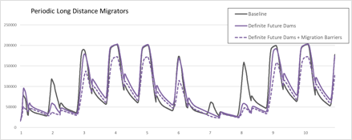
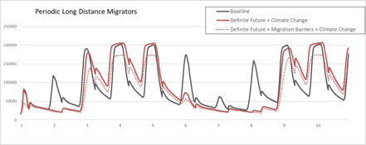
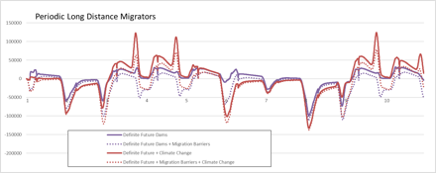
Notes:
Periodic Long Distance Migrators
Overall message: Dams and climate change increase longterm variability in production of PLDM via loss in production during years of reduced peak flooding.
Dams effects alone (top panel)
Severe loss of this group in years of low peak floods which occur in year 2, 7, and 8 (Top graph, purple solid line). Note that in some years when dam effects do not appear to be having a strong effect on production due to their hydrological impacts, the addition of migration barriers alone are found to deplete production by about 50% (Top graph, year 6).
Additional effects of climate change (middle panel)
More extreme long-term variability, for example see that fish production is severely depleted in three consecutive years during years 6-8 in middle panel (where climate change is included), but only 2 in top panel (where dams are considered without climate change).
During high flood years, production is increased relative to baseline in dry season. This is likely a function of increases in some some sources of primary production as permanent lake area is increased. Note - currently the model does not provide a strong link between functional groups and wetland landcovers. Strengthening this link could counteract some of the increases during dry season seen here

Slide 42
Case Studies
Speakers:
Suchi Gopal
Joshua Pitts

Slide 43
Break
Speakers:
Suchi Gopal
Joshua Pitts

Slide 44

Food, Energy, Water Nexus
Speakers:
Suchi Gopal
Joshua Pitts

Slide 45

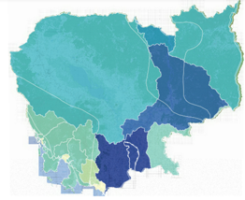
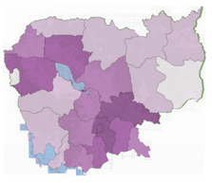


Goals of Building our Approach
Develop and apply computational methodologies, e.g. improved algorithms to integrate different types of data (scales, sensors, types), understand system flows, & interactions;
Create models to understand the coupled human-natural system;
Translate findings into a user-friendly decision tool that supports cyber-human-natural system resource management.
Proprietary and Confidential
45
Notes:
ECONOMIC ANALYSIS OF ECOSYSTEM
SERVICES IN THE MEKONG BASIN
Lucy Emerton
Report prepared for WWF Greater Mekong Programme
20 February 2011

Slide 46
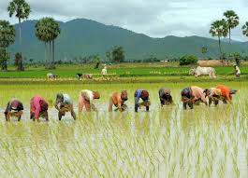
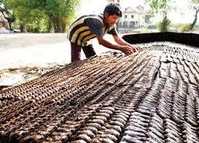
Data for Food Security
The components of food security include:
Crops grown
Family consumption patterns
Fishing consumption
Small farmers
Livestock
Population density
Size of the household etc.
Vulnerability to Climate Change
Proprietary and Confidential
46
Notes:
ECONOMIC ANALYSIS OF ECOSYSTEM
SERVICES IN THE MEKONG BASIN
Lucy Emerton
Report prepared for WWF Greater Mekong Programme
20 February 2011

Slide 47
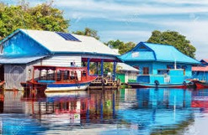
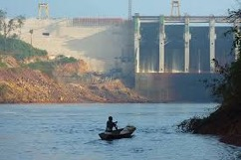
Data for Water Security
The components of water security (World Resource Institute) include:
Total water withdrawal
Consumptive and non-consumptive use
Total blue water (Bt)
Available blue water (Ba)
Baseline water stress
Inter-annual variability
Seasonal variability.
Flood occurrence.
Drought severity…
Upstream storage
Groundwater stress
Return flow ratio
Upstream protected land
Proprietary and Confidential
47
Notes:
ECONOMIC ANALYSIS OF ECOSYSTEM
SERVICES IN THE MEKONG BASIN
Lucy Emerton
Report prepared for WWF Greater Mekong Programme
20 February 2011

Slide 48
Data for Water Security
The components of energy security include:
Per capita consumption of electricity
Coal, HEP and oil consumption
Renewables – solar, wind.
Vulnerability to Climate Change
Factory consumption
Predicting future demand
Proprietary and Confidential
48
Notes:
ECONOMIC ANALYSIS OF ECOSYSTEM
SERVICES IN THE MEKONG BASIN
Lucy Emerton
Report prepared for WWF Greater Mekong Programme
20 February 2011

Slide 49
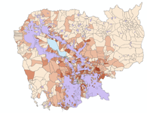
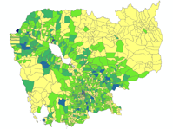
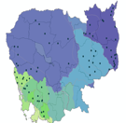
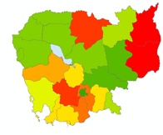
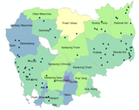
Making Decisions with Big Data in F.E.W.S.
Agriculture + Population Density + Water Availability + Per capita consumption of electricity -> Vulnerability to Climate change (US DOS) at Commune Level
Proprietary and Confidential
49
Notes:
ECONOMIC ANALYSIS OF ECOSYSTEM
SERVICES IN THE MEKONG BASIN
Lucy Emerton
Report prepared for WWF Greater Mekong Programme
20 February 2011

Slide 50
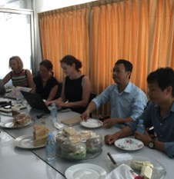
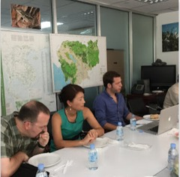
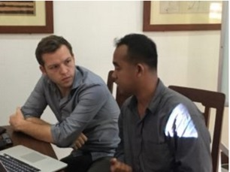
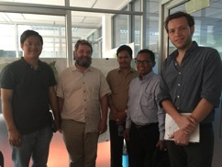
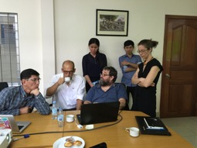
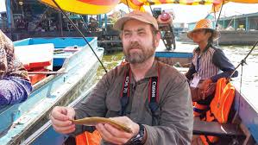
Conveying Decision Making to Stakeholders
50
Notes:
ECONOMIC ANALYSIS OF ECOSYSTEM
SERVICES IN THE MEKONG BASIN
Lucy Emerton
Report prepared for WWF Greater Mekong Programme
20 February 2011

