Slide 1






Simulating the interactions of coupled human and natural systems in South Asia’s largest wetland.
Roelof Boumans, Mauritio Areas, Irit Altman, Les Kaufman, and Suchi Gopal
International Society for Ecological Modeling May 2016
Cambodia
Inland Fisheries Research Development Institute (IFReDI)
Notes:
LABELS ON THE SLIDE?

Slide 2
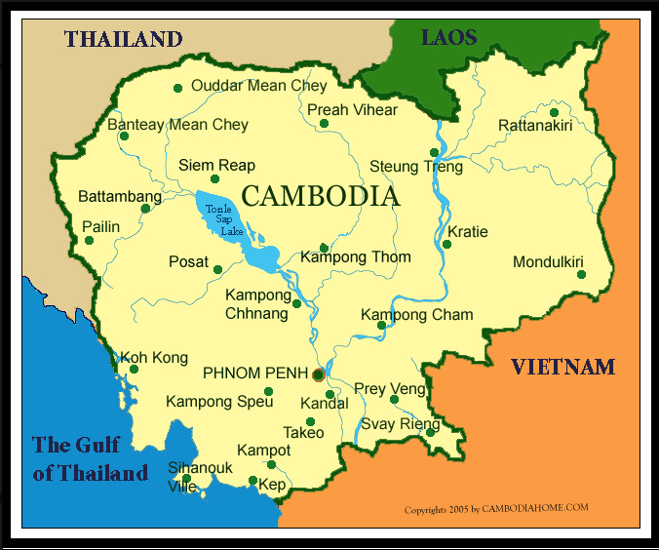
Tonlesap

Slide 3
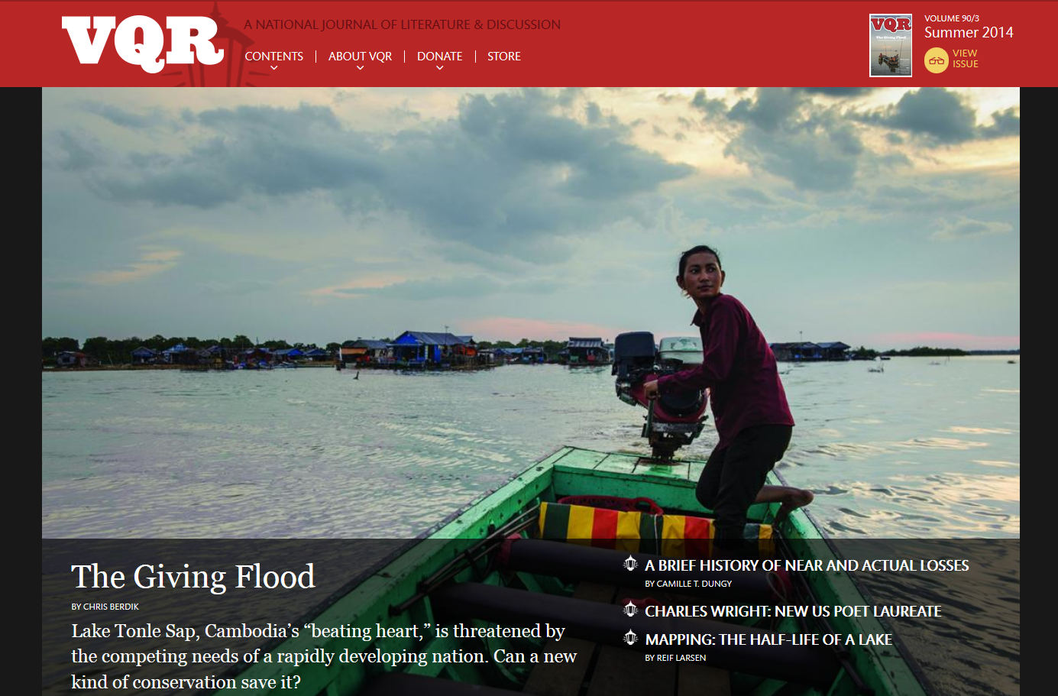
Tonlesap Cambodia

Slide 4
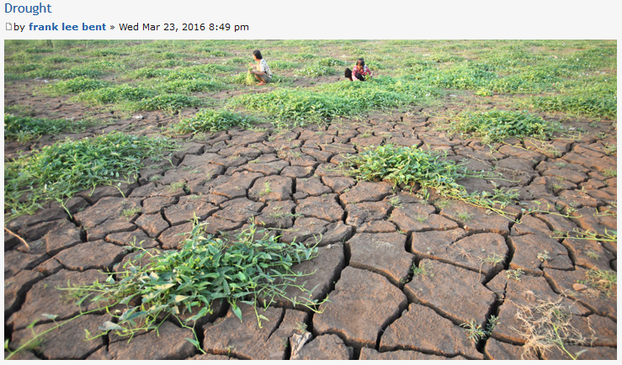
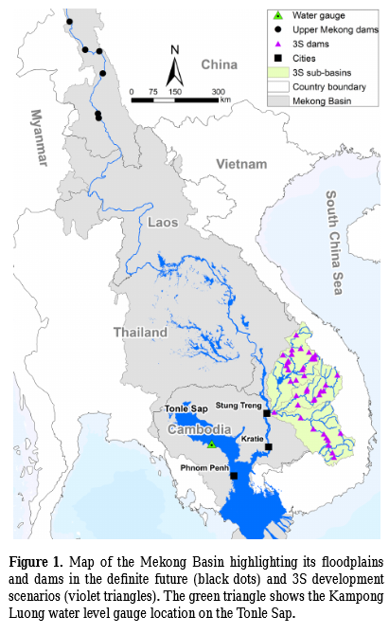
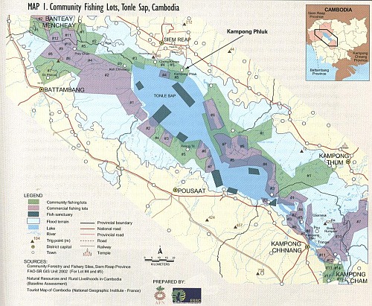
The Issues
“Based on our monitoring, drought has been detected in Cambodia,” said the Mekong River Commission Secretariat. “The current drought situation in the country as of March 2016 could be at least as serious as that in 2015 and may likely be getting worse in coming months.”
Rising population pressures, rapid political changes, and the introduction of new technologies and markets has overwhelmed traditional systems of flood forest and fisheries management.
Over-extraction has drawn down fish populations to a point that threatens many species, while undermining the livelihood of thousands of communities that reside around the lake and along the river.
Arias et al 2014

Slide 5
The Goal :
Create a modeling tool which can incorporate stakeholder input and biophysical data sets for valuation of ecosystem services and decision-making:
  Simulate Ecosystems and Socio-Economic systems in space
  Simulate these systems over time
  Simulate the interactions between these systems through coupling

Slide 6
Scenario Modeling
Characteristics:
Aim is not to predict one exact picture of the future, but to present several alternative future developments.
Possible future outcomes are observable. Observations can be used to validate scenario trajectories
Scenario models are connected to the past, but are not extrapolations
Scenarios do not rely on historical data and do not expect past observations to be still valid in the future.
Scenarios consider potential developments and turning points.
Notes:
CONTRADICTIONS??????

Slide 7
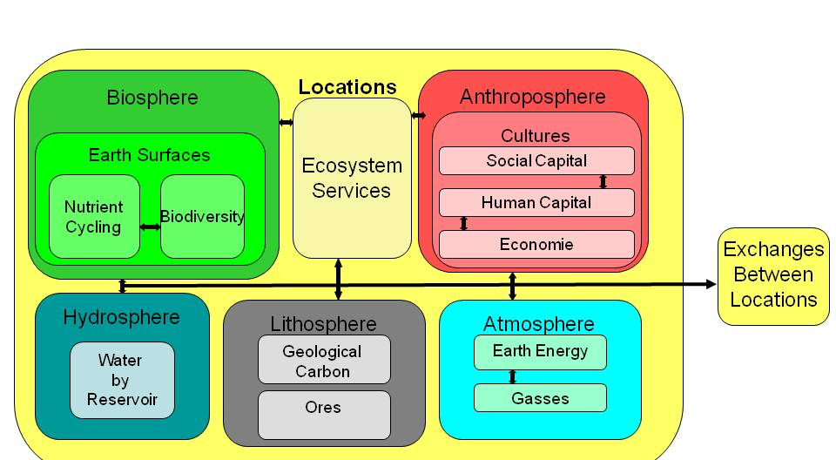
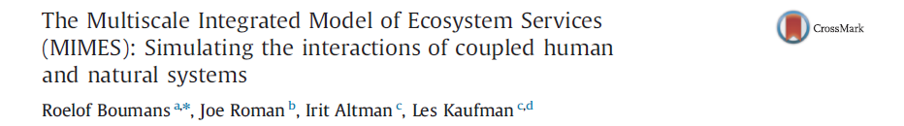
MIMES
The Multi-Scale Integrated Model of Ecosystem Services
Notes:
Can we rework this a bit? Give an example from later slides?

Slide 8
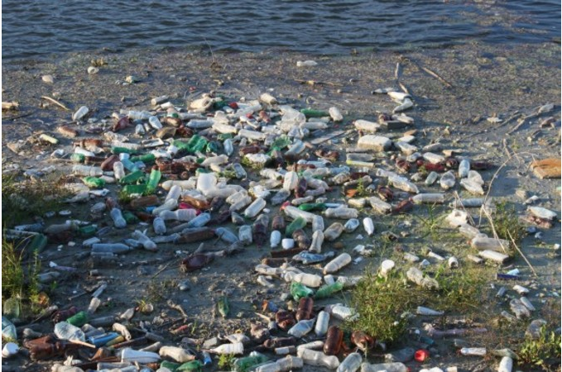

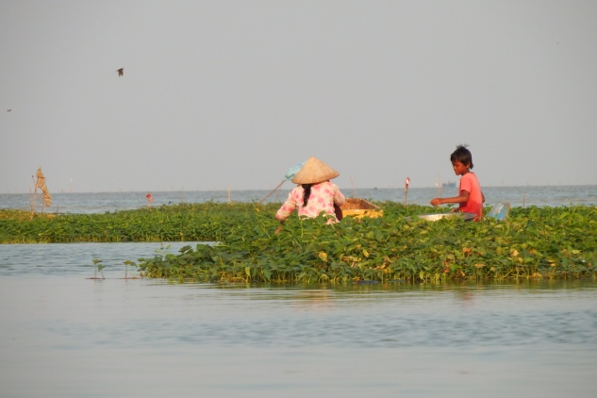

Accounting Framework For Modeling Ecosystem Services
 | Economic sector “Use” | Ecosystem “Use”
Economic Sector “Make” | Human Interactions | Ecosystem Impacts
Ecosystem “Make” | Ecosystem Services | Ecosystem Processes

Slide 9
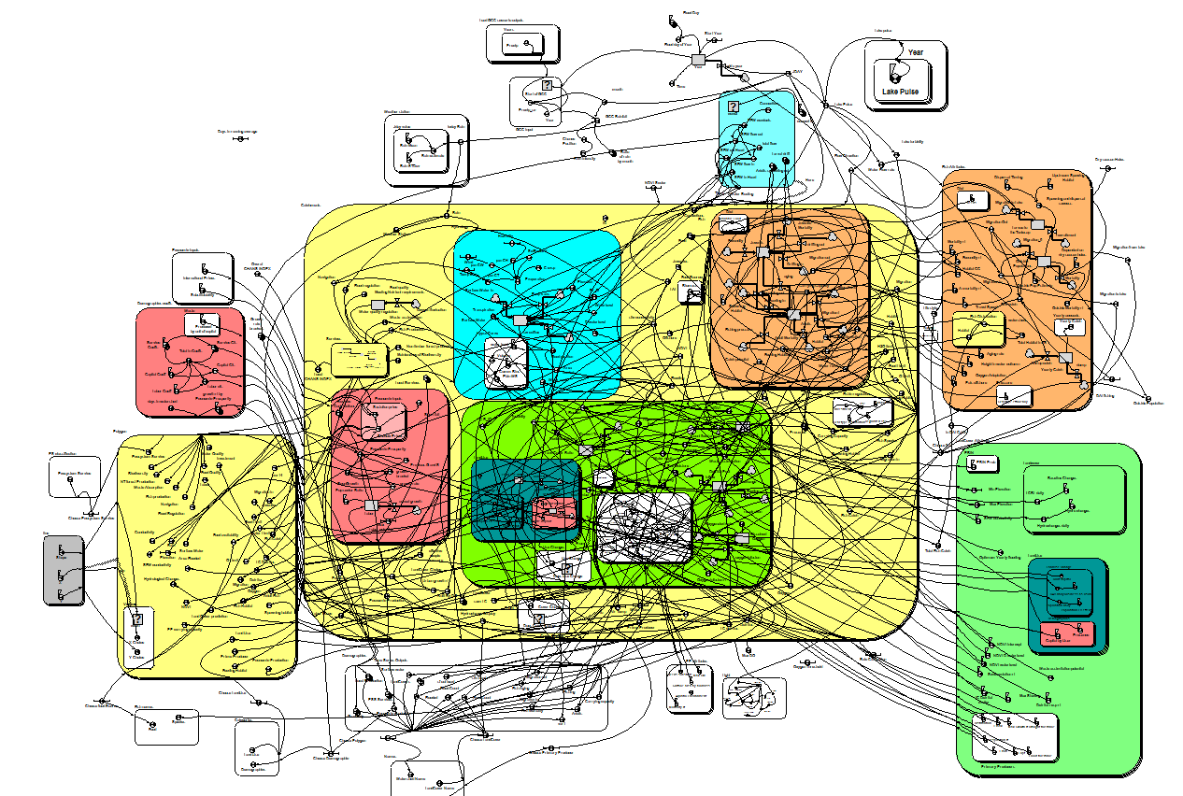
Tonlesap Model Diagram
Time series inputs
Fish attributes and outside dynamics
Hydrology
27 Fish species
User group attributes
30 Locations
4 user groups
12 land covers
4 Land
Uses
Land Cover Attributes
Polygon
outputs
4 p. producers
Land Use Attributes
Time series outputs

Slide 10
Outcomes
1 Changes in local hydrology
2 Changes in land cover
3 Changes in Primary Production
4 Changes in Ecological Production:
  Fish biomass and composition
  Plant biomass and composition
5 Changes in Ecosystem Service Production
6 Changes in Land use opportunities
7 Socio-Economic outcomes.

Slide 11
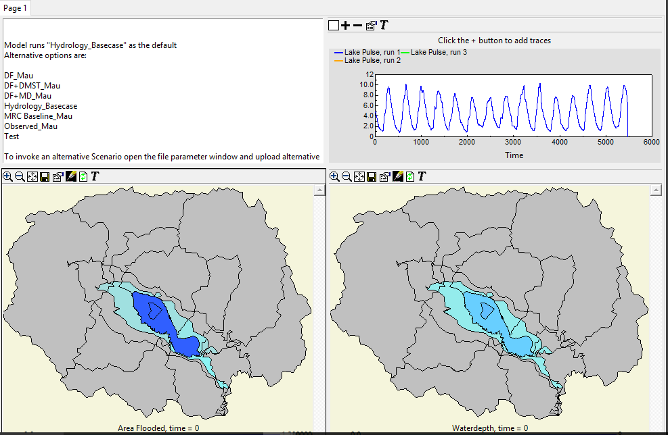
Hydrology

Slide 12
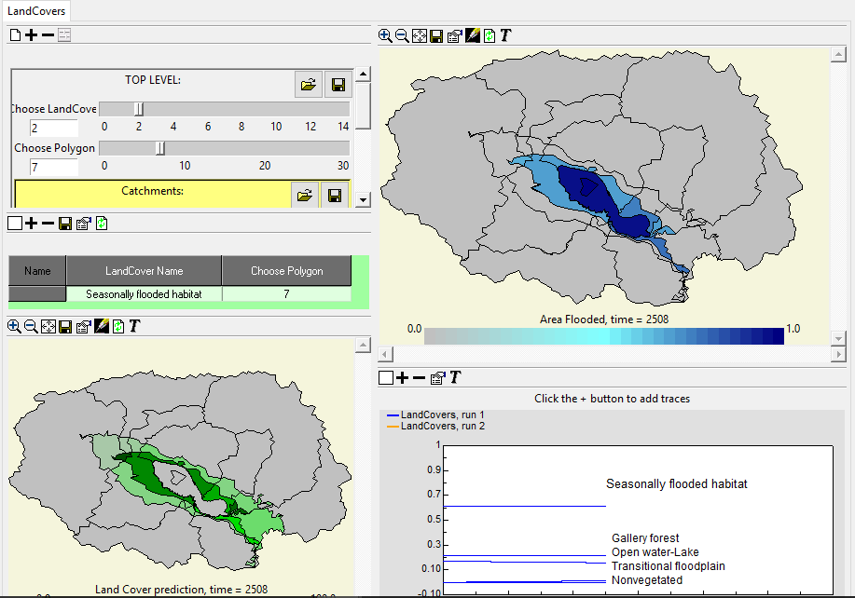
Landcover changes

Slide 13
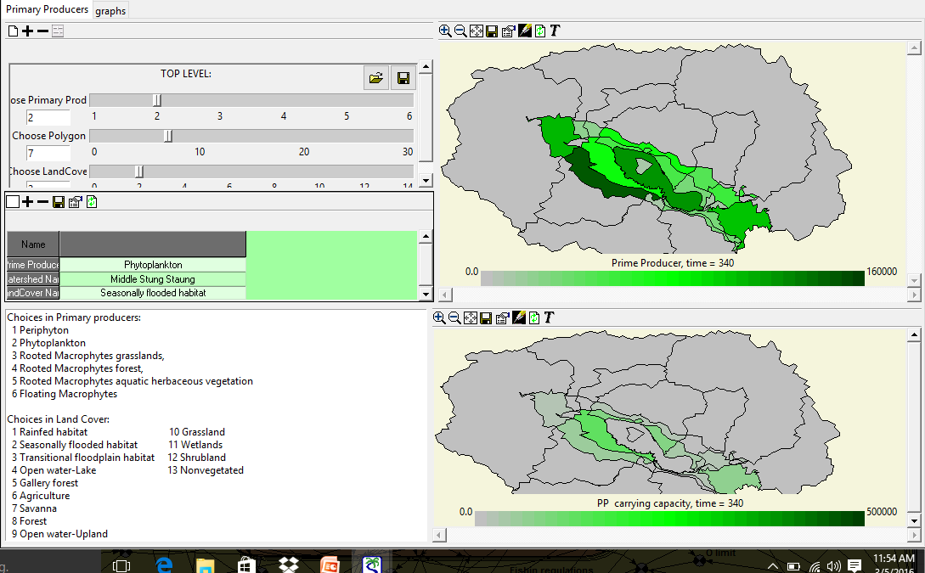
Primary Producers

Slide 14
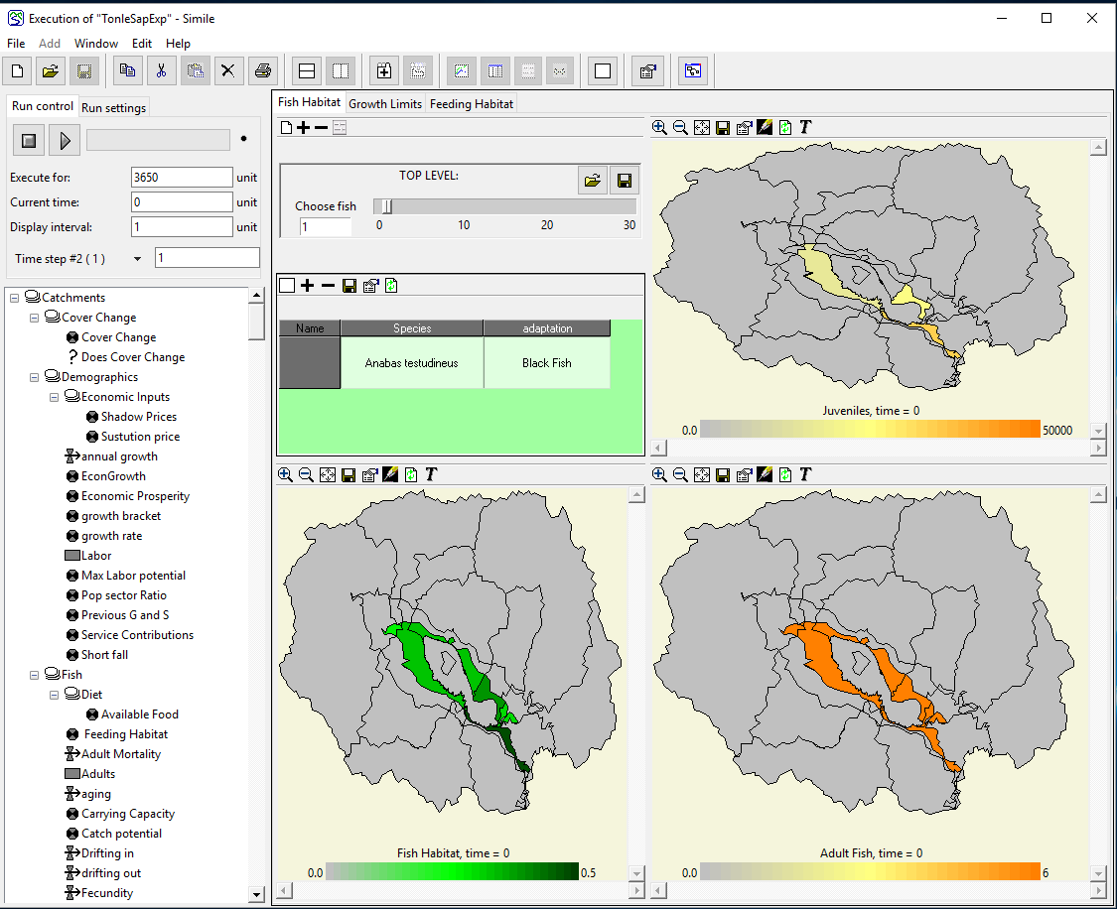
Fish Populations

Slide 15
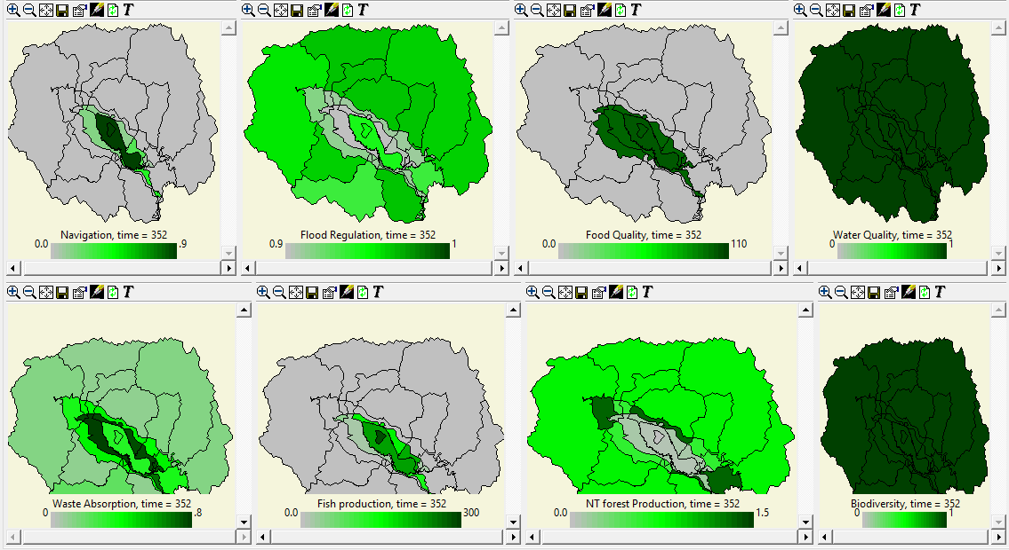
Ecosystem Services

Slide 16
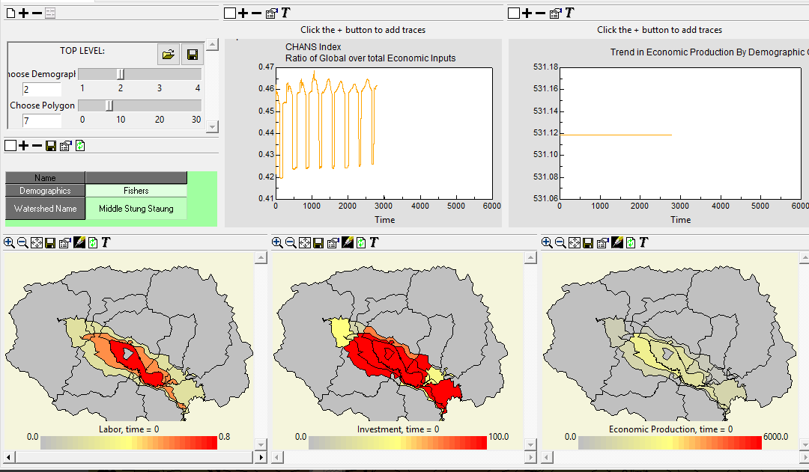
Socio Economic Outcomes

Slide 17
